Slide 1


Powering Innovation in Europe:
the European Institute of
Innovation and Technology (EIT)
Daria Golebiowska-Tataj
EIT Governing Board Member/Executive Committee
Łódź, Poland, 21 June 2012

Slide 2
ABOUT DISCOVERY, INVENTION, TRANSLATION & INNOVATION
1
2
Discovery:
Finding out something not yet known
Invention:
creating or designing something not existing before
3
4
Translation:
processing discoveries and/or invention into innovation
Innovation:
making changes with societal impact based on discoveries and/or invention
Excellent science & research are necessary yet not sufficient ingredients for innovation

Slide 3
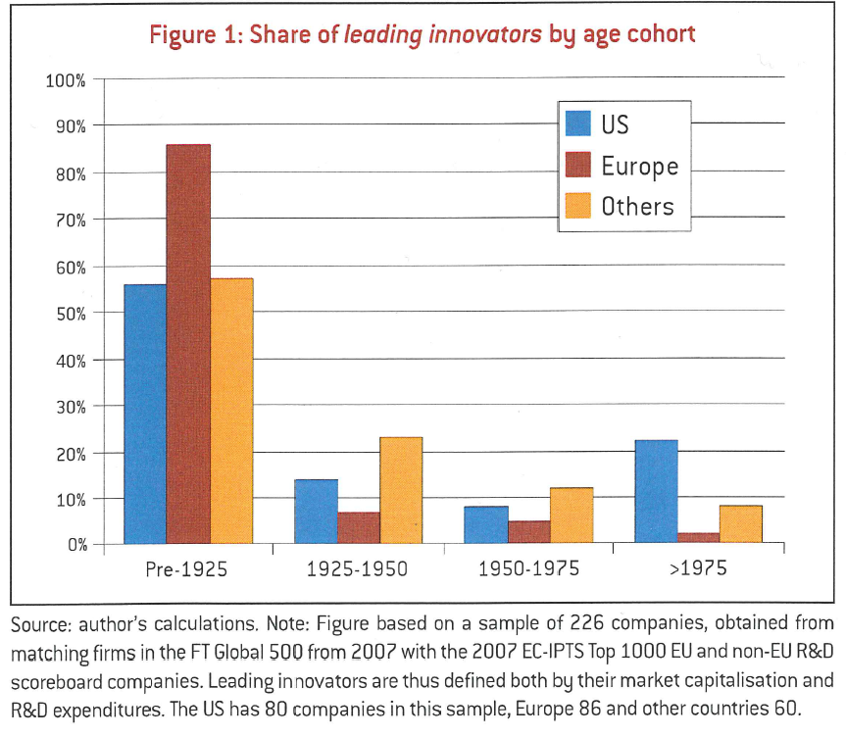
AGE DISTRIBUTION OF COMPANIES’ CONTRIBUTION TO INNOVATION: EUROPE V. US AND OTHERS
US: approx. 21%
EU: approx. 2%
Bruegel policy brief 2009 Reinhilde Veugelers

Slide 4

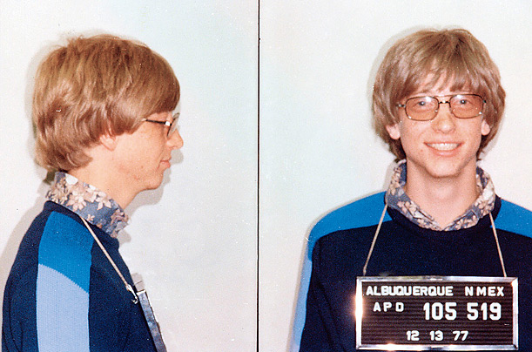
BEHRING, NOBEL, CITROEN, SIEMENS, REUTER = EUROPEAN HISTORY BOYER, GATES AND ZUCKERBERG = U.S. REALITY!
HOW
to motivate kids
to set up garage companies in Europe?
WANTED
wanted

Slide 5

THE CORE OF INNOVATION IS THE
KNOWLEDGE TRIANGLE
Research & technology
Higher Education
ENTREPRENEURIALLY
DRIVEN
INNOVATION
Industry & SMEs
Actors within the knowledge triangle are at the core of the innovation web beyond the traditional collaborative R&D consortia

Slide 6
EUROPEAN INSTITUTE OF INNOVATION AND TECHNOLOGY (EIT)
EIT set up to unlock the European innovation landscape through a new agenda at EU level
EIT is the first initiative of the EU bringing together the three sides of the knowledge triangle with the entrepreneur in the driver’s seat to form the necessary links between education, business and research
MISSION:
“To become the catalyst for a step change in the European Union’s innovation capacity and impact”
Notes:
The EIT’s mission is to facilitate the following transitions of the current European innovation approach:
from idea to product
from lab to market
from student to entrepreneur
by integrating the three sides of the knowledge triangle in areas of high societal need.

Slide 7
THE KNOWLEDGE & INNOVATION COMMUNITIES (KICs)

Slide 8
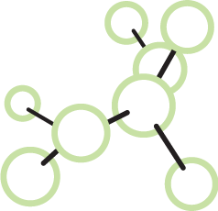
EIT’s ENGINE: ITS INNOVATION FACTORIES (KICs)
highly integrated, creative and excellence-driven autonomous long-term partnerships
internationally distributed but thematically convergent partners
driven by societal challenges and fostering the emergence of entrepreneurs

Slide 9
THE KIC MODEL (1/2)
High degree of integration: each KIC is an independent legal entity, gathering world-class KIC partners from the knowledge triangle based on a contractual relationship/partnership with the EIT.
Long-term strategic approach: each KIC is set up for a minimum of 7 years to eventually become self sustainable.
Sufficient autonomy and flexibility: to determine organisational structure and activities governed by a Board of KIC partner organisations
Effective governance: run by a CEO and a lean management team at central and co-location level.
Notes:
The EIT is striking new paths in knowledge and innovation – especially by operating via its Knowledge and Innovation communities
KIC co-location = a geographical location of a KIC where all or a large part of the innovation web can be found in close proximity working together across the innovation web
You will learn more about the KICs and their structure this afternoon in the session: "Tackling societal challenges through innovation: EIT's Knowledge and Innovation Communities – hubs for innovation

Slide 10
THE KIC MODEL (2/2)
Smart funding & high degree of commitment of partners: EIT funding to KICs is max. 25% of their total budget over time with 75% to be attracted from other sources, both public and private.
The co-location model: each KIC consists of 5-6 world class innovation hotspots building and leveraging on existing European capacities.
Results/High-Impact-oriented activities: KICs implement a Business Plan with measurable deliverables, results and impact
Culture: KICs are shaped by strong entrepreneurial mindsets and cultures
Notes:
The EIT is striking new paths in knowledge and innovation – especially by operating via its Knowledge and Innovation communities
KIC co-location = a geographical location of a KIC where all or a large part of the innovation web can be found in close proximity working together across the innovation web
You will learn more about the KICs and their structure this afternoon in the session: "Tackling societal challenges through innovation: EIT's Knowledge and Innovation Communities – hubs for innovation

Slide 11



THE FIRST 3 KICs
Designated in December 2009 by the EIT Governing Board
Notes:
The EIT is striking new paths in knowledge and innovation – especially by operating via its Knowledge and Innovation communities
KIC co-location = a geographical location of a KIC where all or a large part of the innovation web can be found in close proximity working together across the innovation web
You will learn more about the KICs and their structure this afternoon in the session: "Tackling societal challenges through innovation: EIT's Knowledge and Innovation Communities – hubs for innovation

Slide 12
KIC PARTNERS: 2010-2012
Climate-KIC 86 KIC Partners
EIT ICT Labs 75 KIC Partners
KIC InnoEnergy 104 KIC Partners
In 2012, the three KIC brought together over 260 KIC Partners

Slide 13
KIC FUNDING SOURCES 2010-2012
 | 2010 | 2011 | 2012 | Total
EIT | 30.09 | 59.21 | 81.72 | 171.01
NON EIT | 86.25 | 240.96 | 283.15 | 610.36
TOTAL | 116.33 | 300.17 | 364.86 | 781.36

Slide 14
Climate-KIC
Mission: Climate-KIC aims to significantly accelerate the innovation required for a transformation to a low-carbon economy, and to ensure Europe benefits from new technologies, company growth and jobs.
Thematic Focus Area: assessing climate change and managing its drivers, transitioning to resilient, low-carbon cities, advancing adaptive water management and developing zero carbon production systems
Governance: CEO - Mary Ritter, Chairman - John Schellnhuber
Partners inc. Bayer, EDF, GDF Suez, DSM, Schipol Airport ETH Zurich, Imperial College London, Potsdam Institute for Climate Impact Research PIK, Technische Universität Berlin, Forschungszentrum Jülich GmbH, l’Institut national de la recherche agronomique INRA, Delft University of Technology & Utrecht University,…

Slide 15
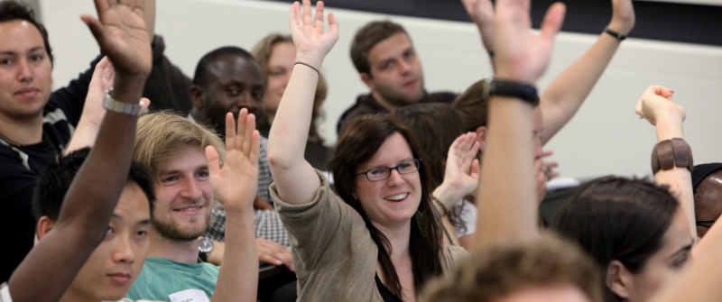


Climate-KIC
Climate-KIC brings together the most committed and skilled partners needed to realize sustainable climate change innovations, be it new technologies or services. Climate-KIC addresses four important markets:
Climate-KIC Education attracts and develops
future climate entrepreneurs and change agents
Climate-KIC Innovations creates promising
new collaborations and pioneers new value-chain
configurations
Climate-KIC Pathfinder creates new pathways
to low-carbon prosperity by fostering the conditions
for ongoing innovation
Climate-KIC Entrepreneurs builds platforms to
connect and support the wider climate entrepreneurship community
Notes:
The EIT is striking new paths in knowledge and innovation – especially by operating via its Knowledge and Innovation communities
KIC co-location = a geographical location of a KIC where all or a large part of the innovation web can be found in close proximity working together across the innovation web
You will learn more about the KICs and their structure this afternoon in the session: "Tackling societal challenges through innovation: EIT's Knowledge and Innovation Communities – hubs for innovation

Slide 16
EIT ICT Labs
Mission: EIT ICT Labs intends to turn Europe into the global leader in ICT innovation by establishing a new type of partnership between leading companies, research centres and universities in Europe.
Thematic Focus Area: smart spaces, smart energy systems, health and wellbeing, digital cities of the future, future media and content delivery and intelligent mobility and transportation systems
Governance: CEO – Willem Jonker , Chairman – Henning Kagermann
Partners inc. Alcatel Lucent, Fraunhofer, KTH, Nokia, Aalto University, Ericsson, INRIA, Philips, Orange, SAP, Siemens, TRENTO Rise, Universite Paris Sud, Telecom Italia, VTT,...

Slide 17


EIT ICT Labs
The EIT ICT Labs innovation catalysts are the key instruments in achieving its strategy. The innovation catalysts address instances of the “knowledge triangle” and the interfaces between education, research and business.
EIT ICT Labs breeds entrepreneurial ICT top talent via
the transformation of higher education to promote creativity
and entrepreneurial spirit.
This community speeds up ICT innovation by bringing people
together from different countries, disciplines and organizations
via mobility programmes and co-location centres.
EIT ICT Labs generates world-class ICT business via
broader and faster industrialization of research results.
Notes:
The EIT is striking new paths in knowledge and innovation – especially by operating via its Knowledge and Innovation communities
KIC co-location = a geographical location of a KIC where all or a large part of the innovation web can be found in close proximity working together across the innovation web
You will learn more about the KICs and their structure this afternoon in the session: "Tackling societal challenges through innovation: EIT's Knowledge and Innovation Communities – hubs for innovation

Slide 18
KIC InnoEnergy
Mission: KIC InnoEnergy’s strategic objective is to become the leading engine of innovation in the field of sustainable energy.
Thematic Focus Area: energy form chemical fuels, renewables, clean coal technologies, sustainable nuclear and renewable energy convergence, intelligent, energy efficient buildings and cities and european smart electric grid and electric storage
Governance: CEO - Diego Pavia, Chairman - Karl-Friedrich Ziegahn
Partners inc. EnBW, Vattenfall, Karlsruhe Institute of Technology (KIT), Grenoble Ecole de Management, CEA, EDF, VITO, ESADE, Gas Natural Fenosa, TNE, K.U. Leuven, ABB, KTH, AGH University of Technology, Central Mining Institute,…

Slide 19
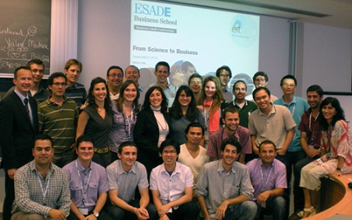

KIC InnoEnergy
With a focused portfolio of activities, KIC InnoEnergy looks for market impact:
Master of Sciences, PhD Schools or life long learning tailored to the market needs. With a specialization in at least one of the thematic topics, hands on for 4 months experience in industry, tuition in entrepreneurship and new management skills, finalizing with a guided business case on a real industrial need, from its design to launching its execution.
Dedicated Research, Development & Innovation teams compiled from the key technicians of our top rank shareholders better fit to solve the singular energy requirements with disruptive market impact
Business Creation Services or the KIC InnoEnergy Highway, with which we transform an idea into a business or help to create the workflow of “innovation to business” in existing institutions
Notes:
The EIT is striking new paths in knowledge and innovation – especially by operating via its Knowledge and Innovation communities
KIC co-location = a geographical location of a KIC where all or a large part of the innovation web can be found in close proximity working together across the innovation web
You will learn more about the KICs and their structure this afternoon in the session: "Tackling societal challenges through innovation: EIT's Knowledge and Innovation Communities – hubs for innovation

Slide 20
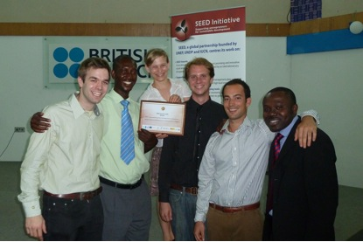
KICs - SOME EARLY ACHIEVEMENTS
Climate-KIC: As a result of a business plan competition, two Climate KIC projects have been awarded seed funding. One group,
DeCo! won the International SEED Award 2010
through a business plan competition
EIT ICT Labs: InterneT of ThiNGs (FITTING) project has received € 5.8 million funding from the French national research agency (ANR) to develop new internet technology
KIC InnoEnergy: Its postgraduate degree programmes are hugely popular already in their first year: 850 students applied for
200 available places

Slide 21
KICs’ Achievements From 2010 to end of 2012 (foreseen)
No of Education Programmes (MSc / PhD) = 20
No of Students = 1070
No of Innovation Projects = 100
No of Start-ups = 27
No of Products/Services = 100
No of Patents = 35
No of Publications = 86

Slide 22
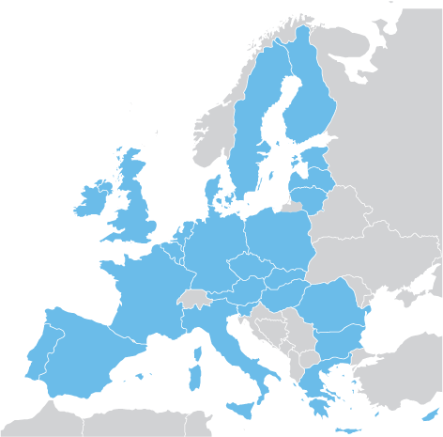
KICs’ EUROPEAN IMPACT &
GOOD PRACTICE
Climate-KIC:
Co-location centre
RIC (Regional Implementation and
Innovation Centre)
EIT ICT Labs:
Co-location centre
Associate Partner
KIC InnoEnergy
Co-location centre

Slide 23
EIT DRIVING CROSS-KIC AGENDAS
EDUCATION
Promoting excellent education for creativity, innovation and entrepreneurship by high quality EIT labelled degree programmes, fostering a vibrant EIT student & alumni community.
ENTREPRENEURSHIP
Promoting a risk taking mindset and culture by creating more favourable environments for passionate entrepreneurial talent and entrepreneurship driven innovation to flourish.
WORLD-CLASS INNOVATION
Developing innovative ecosystems to create and grow world-class, breakthrough innovations by exploiting KIC synergies and complementarities at European level (cross-border).

Slide 24

CONCLUSIONS KIC MODEL
3 KICs were set-up (legal, governance, financial, organisational and operational), are up and running and delivering in record time
Until now, over 200 KIC partners; total investment exceeding 400 MEUR (EIT contribution of 85 MEUR in 2010 and 2011)
KICs are unique entities in EU/global landscape with huge potential to deliver results and innovation models

Slide 25
The EIT STRATEGIC INNOVATION AGENDA (2014 – 2020)

Slide 26
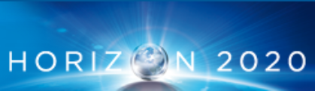
Horizon 2020 and the EIT
EIT contribution to H2020:
address societal challenges via the
integration of the knowledge triangle
EIT contribution to H2020 overall policy objectives
EIT is an integral part of
Horizon 2020

Slide 27
Strategic Innovation Agenda (SIA) and its Priorities :
→ The European Commission presented a proposal for the EIT SIA and the amended EIT Regulation the European Parliament and Council on 30 November 2011
1
Investing in KICs: Consolidation of the existing 3 KICs
2
Investing in KICs:
Creating new KICs (2014 to 2020)
3
Enhance EIT impact via knowledge sharing
4
Enhance EIT impact via simplification & monitoring
Notes:
Themes:
2014: food4future, raw materials and healthy living & active ageing
2018: added value manufacturing, smart secure societies & urban mobility

Slide 28
Investing in the KICs
→ Proposed themes for future KICs:
2014: food4future, raw materials, healthy living& active ageing
2018: added value manufacturing, smart secure societies, urban mobility
Proposed Budget:
H2020 financial contribution to the EIT: 3.18 billion € for 2014-2020.

Slide 29
THE EIT’s ROLE IN THE EUROPEAN INNOVATION LANDSCAPE
The EIT will play a distinctive role within Horizon 2020 while maintaining a strong link with the European Higher Education Area (EHEA)

Slide 30

EIT Conference: Good Practices and Learning
Integrating the Knowledge Triangle: Lessons learnt by the EIT
Date: 25 & 26 June
Venue: Copenhagen Business School
Aim:
share practical experiences at all three levels of the EIT : the Institute, the KICs and their co-location centres;
showcase concrete manner the achievements and lessons learnt so far;
an EIT, outward-looking event.

Slide 31
C
L
R
L
E
E
L
E
V
E
R
A
G
A
A
R
T
D
N
E
... Research on the move! …
… Innovation powered by EIT! …
… Entrepreneurs in the making! …

